Slide 1
9
Bab
Ergonomi di Tempat Kerja

Slide 2
Module Outline (Sub-topics)
9.1. Facet of ergonomics
9.2. Workplace musculoskeletal disorder
9.3. Manual handling
9.4. Ergonomic risk identification and assessment
9.5. Sources of ergonomic hazards
9.6. Mechanical Handling Equipment
9.7. Risk Control Options

Slide 3
Ergonomics :
♦ ″ the law of work″
♦ Designing jobs, equipment, and work tasks to fit human physical characteristics and energy limitations
♦ It considers body dimensions, mobility, and the body’s stress behavior
♦ ″ Make the work fit the person, not the person fit the work″
Ergos = work ; Nomos = laws
″ the law of work″

Slide 4
A number of factors play a role in Ergonomics; these include body posture and movement (sitting, standing, lifting, pulling and pushing), and environmental factors (noise, lighting, temperature, humidity). (Dul et al 1993).
The goal of Ergonomics is to provide maximum productivity with minimal cost; in this context cost is expressed as the physiological or health cost to the worker

Slide 5
Ergonomics Applies to…
Workstation Design—(desks, chairs, space, layout)
Work Postures (sitting, standing, reaching, lifting)
Work Organization (Pace, Breaks, Variety)
Tools, Equipment, and Furniture Design---(body size, height, gender, promoting neutral postures, reduced vibration, exposure to acceptable lighting, noise, temperature)
Manual Materials Handling—(lifting, lowering, pulling, pushing, carrying and holding materials)
Work Environment—(ventilation, noise, temperature & humidity, lighting and vision)

Slide 6
Advantage of Ergonomics
safer jobs with fewer injuries
increased efficiency and productivity
improved quality and fewer errors
improved morale
Ergonomic Objectives
Finding ways to make strenuous, often repetitive work, less likely to cause muscle and joint injuries -- and still get the job done.
Keeping young bodies from wearing out prematurely, and mature bodies from giving out early.

Slide 7
WORK-RELATED MUSCULOSKELETAL DISORDERS

Slide 8
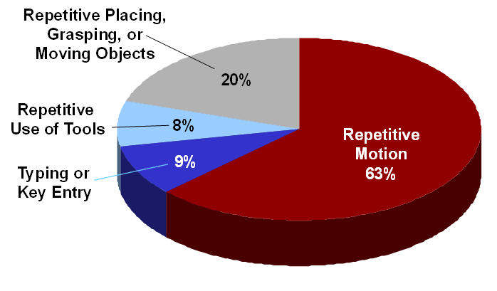
Nationally, almost 60% of all
work-related illnesses are
MSDs
MSD-Type Injuries

Slide 9
The Problem is Widespread The Top 12 Standard Industrial Classifications (SIC)
SIC
Industry
WMSDs per year
805
Nursing, Personal Care Facilities
2,177
421
Trucking and Courier Services (non-air)
1,591
541
Grocery Stores
1,486
152
General Bldg Contractors, Residential
1,361
174
Masonry, Tile, Plaster
703
836
Residential Care
445
242
Sawmills, Planing Mills
432
175
Carpentry, Floor Work
429
078
Landscape, Horticultural
420
451
Air Transportation, Air Courier
411
176
Roofing, Siding, Sheet Metal
388
177
Concrete Work
287
Total
10,130
These 12 SICs alone account for 20% of WMSDs
WMSD: Work-Related Musculoskeletal Disorders
Source: SHARP Report No. 40-4a-2000

Slide 10
Current Federal Law
OSHA: The federal law (OSHA Ergonomics Standard) was issued on November 14, 2000 and was scheduled to be effective on January 16, 2001
OSHA General Duty Clause
Each employer “shall furnish to each of his employees employment and a place of employment which are free from recognized hazards that are causing or are likely to cause death or serious physical harm to his employees”

Slide 11
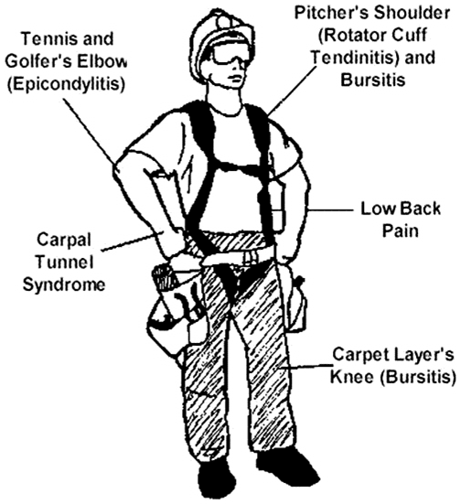
Work-Related Musculoskeletal Disorders (WMSDs) are occupational disorders that involve soft tissues such as muscles, tendons, ligaments, joints, blood vessels, cartilage, spinal discs and nerves

Slide 12
MSDs do not include injuries caused by slips, trips, falls or other similar accidents.
MSDs can differ in severity from mild, periodic symptoms to severe, chronic and debilitating conditions.

Slide 13
WMSDs
♦ Daily stress to anatomical structures that may occur when a person is exposed to certain high risk activities
♦ If the accumulating stress exceeds the body’s normal recuperative ability, inflammation of the tissue can follow
♦ Chronic inflammation may lead to the development of WMSDs
♦ May require weeks, months or years for development - and for recovery

Slide 14
What is The Musculoskeletal System?
The Musculoskeletal System includes the following:
Bones – The load-bearing structure of the body
Muscles- Tissue that contract to create movement
Tendons – Tissues that connect muscles to bones
Ligaments – Tissues that connect bones to bones
Cartilage – Tissue that provides cushioning and reduces friction between bones
Nerves – Communication system that links muscles, tendons and other tissue with the brain
Blood Vessels – Tubes that circulate nutrients throughout the body

Slide 15
Examples of WMSDs
Sprain – Overstretching or overexertion of a ligament that results in a tear or rupture of the ligament
Strain – Overstretching or overexertion of a muscle or tendon
Tendonitis – Inflammation of the tendon inside the sheath
Tenosynovitis – Inflammation of the sheath around the tendon
Carpal Tunnel Syndrome – Compression of the median nerve as it passes through the carpal tunnel in the heel of the hand

Slide 16
..........Examples of WMSDs
Tennis elbow or Golfer’s elbow – Medical term is Epicondylitis – inflammation of the tendons at the elbow.
Trigger Finger – Common term for tendonitis or tenosynovitis that causes painful locking of the finger(s) while flexing
Pitcher’s Shoulder – Rotator cuff tendonitis – inflammation of one or more tendons at the shoulder
White Finger – Medical term is Reynaud’s Phenomenon – constriction of the blood vessels in the hands and fingers
Digital Neuritis – Compression of the nerves along the sides of the fingers or thumbs

Slide 17
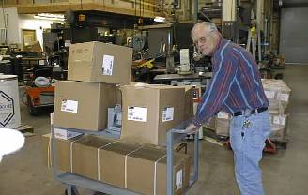
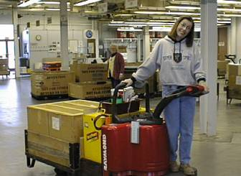
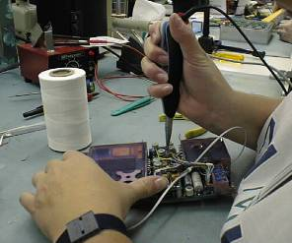
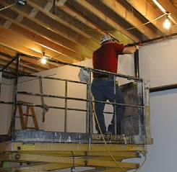
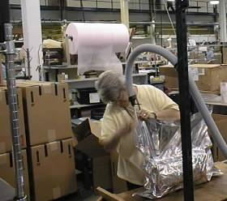

Slide 18
WMSDs are sometimes referred to using other unfamiliar terms such as :
Cumulative Trauma Disorders – CTD
Repetitive Trauma Disorders – RTD
Repetitive Strain Injuries – RSI
Repeated Motion Disorders – RMD
Overuse Syndromes

Slide 19
COMMON CAUSES:
Repetitive and/or prolonged activities
Awkward postures/positions for an extended time
Static postures
Vibration
High/low Temperatures for an extended time
Forceful exertions

Slide 20
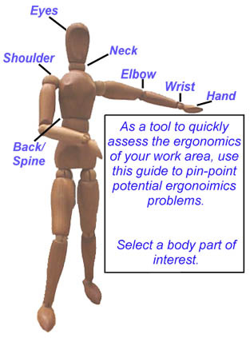
ERGONOMIC STRESS AREAS
Hip
Knee

Slide 21
SIGNS OF MSD
Decreased range of motion
Loss of function
Deformity
Cramping
Loss of color
Decreased grip strength
Loss of balance
Swelling
Redness

Slide 22
SYMPTOMS OF MSD
Muscle fatigue or pain
Aching
Burning
Numbness
Stiffness
Tingling

Slide 23
EXAMPLES OF MSD
TENDONITIS- An inflammation of the tendon. Typically occurs in the shoulder, wrist, hands, or elbow.
CARPAL TUNNEL SYNDROME- Irritation of the median nerve, which runs through a bony channel in the wrist called the carpal tunnel. Usually results from excessive flexing or twisting of the wrist.

Slide 24
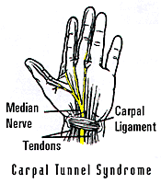
CARPAL TUNNEL SYNDROME

Slide 25
MSD CONT.....
TRIGGER FINGER SYNDROME- Tendons in the fingers become inflamed, causing pain, swelling, and a loss of dexterity.
EYE STRAIN - The eyes become strained as a result of poor lighting, glare or viewing from awkward positions.
HAND/ARM VIBRATION SYNDROME- Tingling, numbness, blanching, loss of dexterity in the hand/arm
MUSCLE STRAIN – Pain in muscles

Slide 26
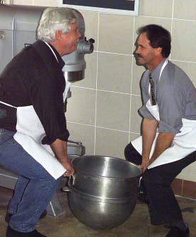
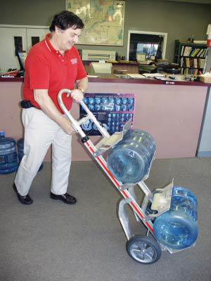
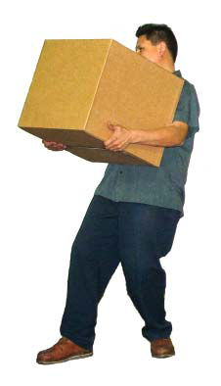
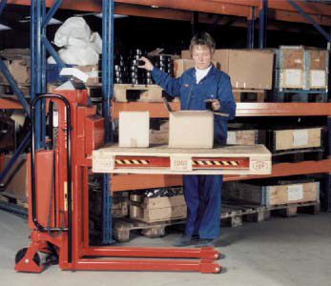
Manual Handling
″Moving anything by using human energy″
Manual handling is transporting or supporting a load by hands or bodily force - This includes:
Lifting
Carrying
Putting down
Pushing
Pulling
Moving
Supporting

Slide 27
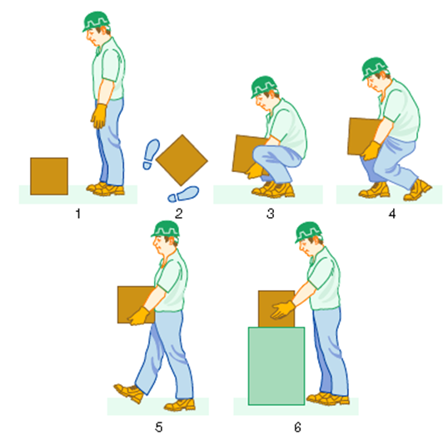
The main elements of a good lifting technique
1. Check suitable clothing
and assess load.
Heaviest side to body.
2. Place feet apart – bend knees.
3. Firm grip – close to body.
Slight bending of back, hips
and knees at start.
4. Lift smoothly to knee level and then
waist level. No further bending of back.
5. With clear visibility move forward without twisting.
Keep load close to the waist.
Turn by moving feet. Keep head up. Do not look at load.
6. Set load down at waist level
or to knee level and then on the floor.

Slide 28
Factors to consider when selecting lifting and handling aids
Involve employees and safety representatives during assessment and when considering possible solutions, so that you can be sure what you propose will work in practice and won’t introduce any new hazards.
Seek advice from suppliers on the suitability of new lifting and handling aid equipment.
Check equipment is CE-marked and within the safe working load.
Consider what maintenance will be required.
Consider whether the equipment will suit the area it will be used in, e.g. is there enough room to maneuver or enough headroom?
Check that the equipment is suitable for the floor area in terms of stability and ground surface.
Consider other factors associated with introducing lifting and handling aids, e.g. site safety, training, information and support.

Slide 29
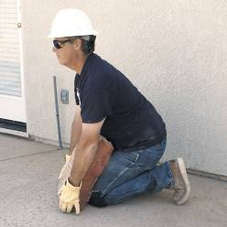
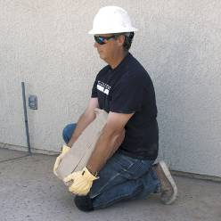
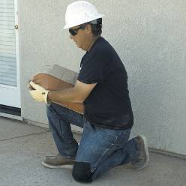
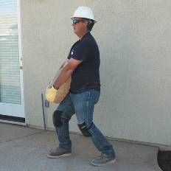
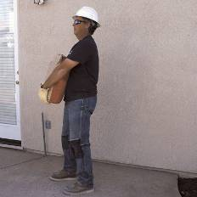
AVOID LIFTING FROM THE FLOOR

Slide 30
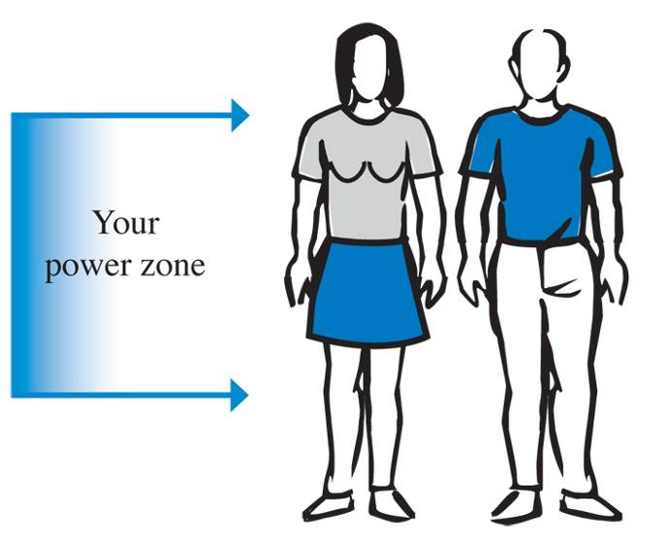
POWER ZONE

Slide 31
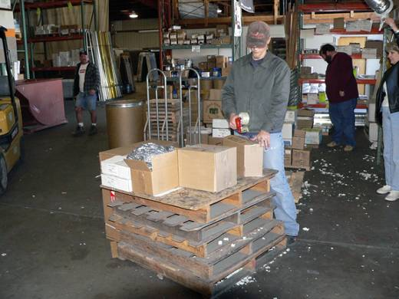
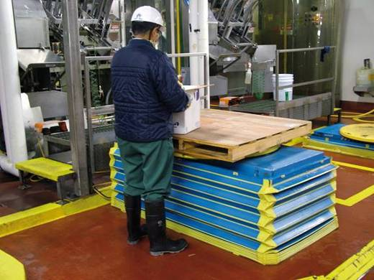
POWER ZONE

Slide 32
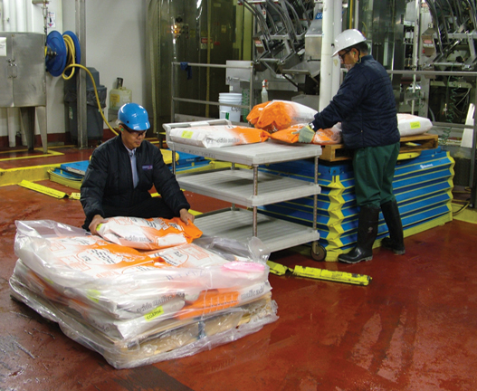
SLIDE the LOAD

Slide 33
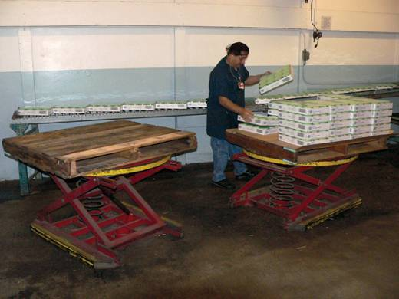
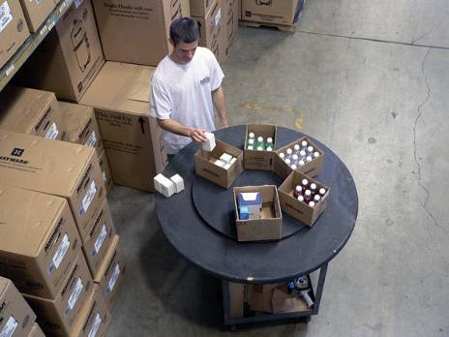
WORK CLOSER

Slide 34
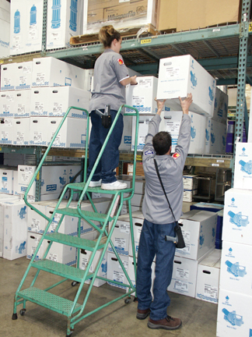
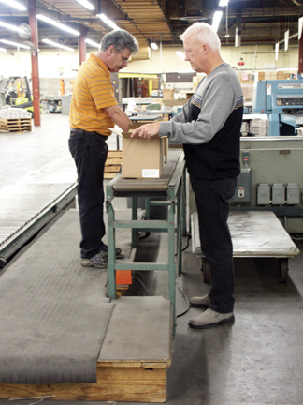
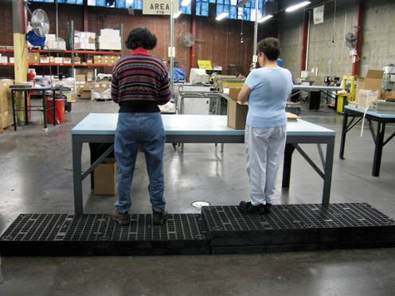
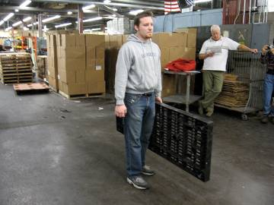
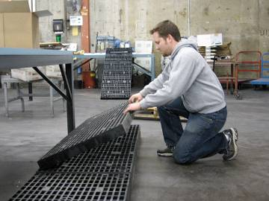
AVOID AWKWARD POSTURES

Slide 35
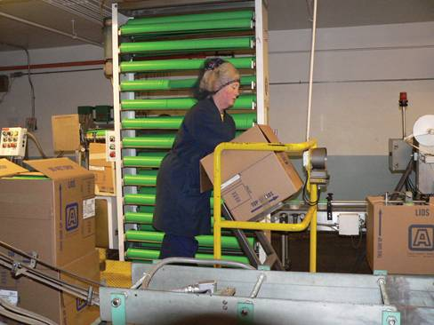
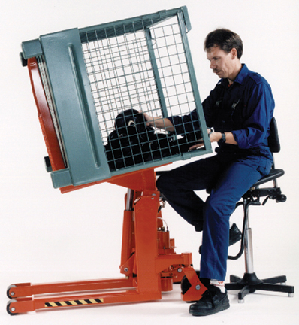
TILT

Slide 36
ALTERNATIVES TO MANUAL HANDLING
USE EQUIPMENT
NON-POWERED
POWERED
( See Mechanical Handling Equipment)

Slide 37
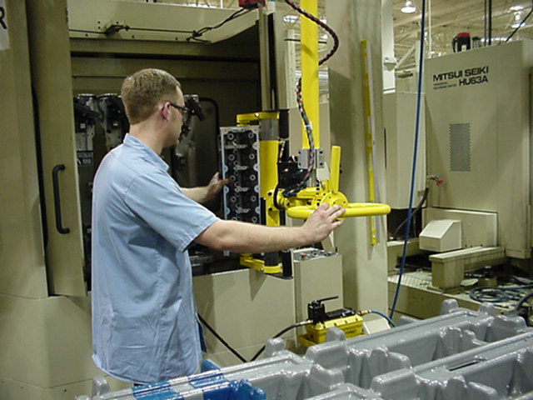
Mechanical/Material Handling Equipment
Manipulators making easy work of handling cylinder heads in a machining center

Slide 38
Equipment: Classification by Types
Hand Trucks: dollies, wheeled trucks for manual transport of all material.
Powered Trucks: forklifts (powered by propane, battery or gasoline), tractor-trailer trains, and other vehicles.
Cranes and Hoists: specialized overhead equipment for lifting and manipulating heavy objects usually powered.
Conveyors: move large quantities of materials over a fixed path. Can be continuously moving or use gravity.
Automated Guided Vehicle Systems (AGVS): powered vehicles that automatically follow a fixed path.
Automated Storage/Retrieval Systems (ASRS): mechanized systems that automatically store and retrieve items.
Others indexing table, pipelines

Slide 39
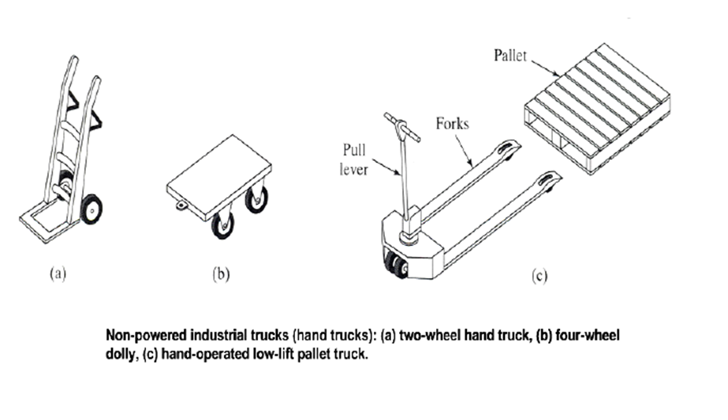

Slide 40
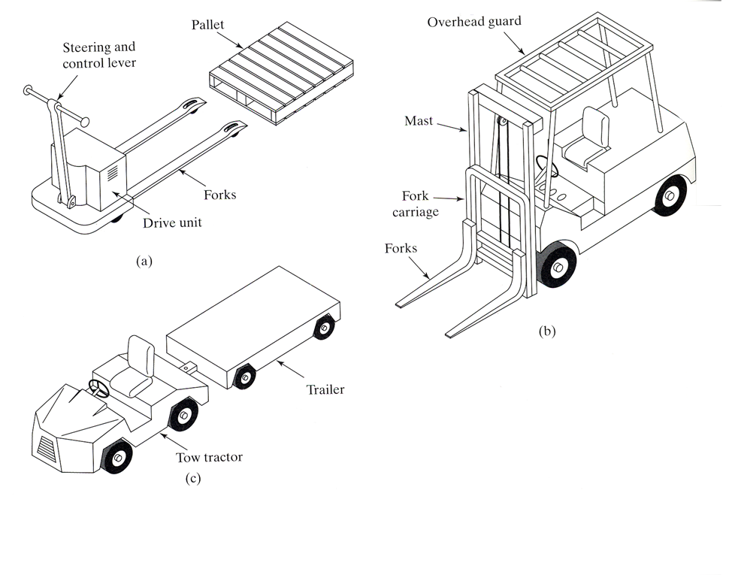

Slide 41
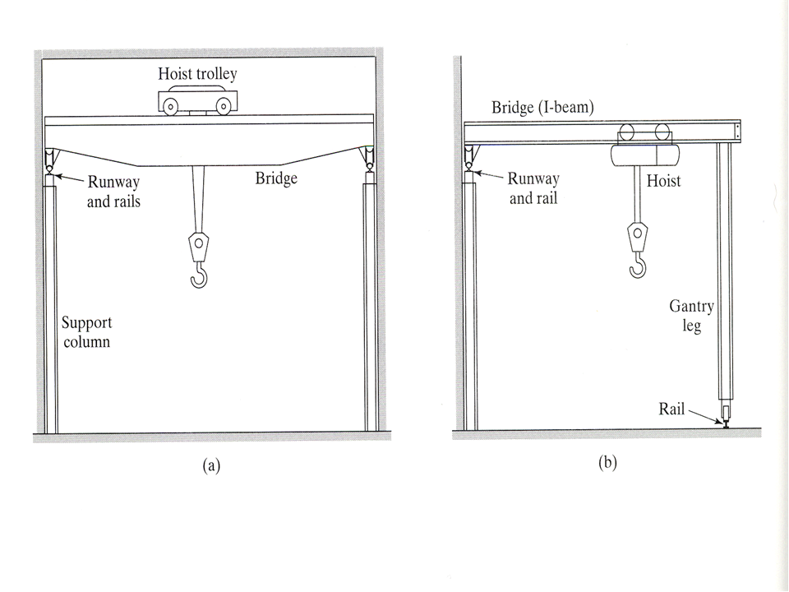

Slide 42
Conveyor Systems: Types of Conveyors
Roller: a series of short tubes roll under the action of gravity or powered ( belts or chains). Very common.( Skate – wheel conveyors)
Belt: a continuous belt loop driven by pulleys for moving pallets, parts or bulk materials (troughed).
Overhead trolley: an endless moving cable or chain carries trolleys on overhead rails. Hooks or baskets suspended from the trolleys to carried loads.
In-floor tow line: a moving cable or chain buried in the floor moves wheeled trailer carts along a fixed path.
Cart-on-track: individual carts ride on tracks driven by rotating tube. (high positioning)

Slide 43
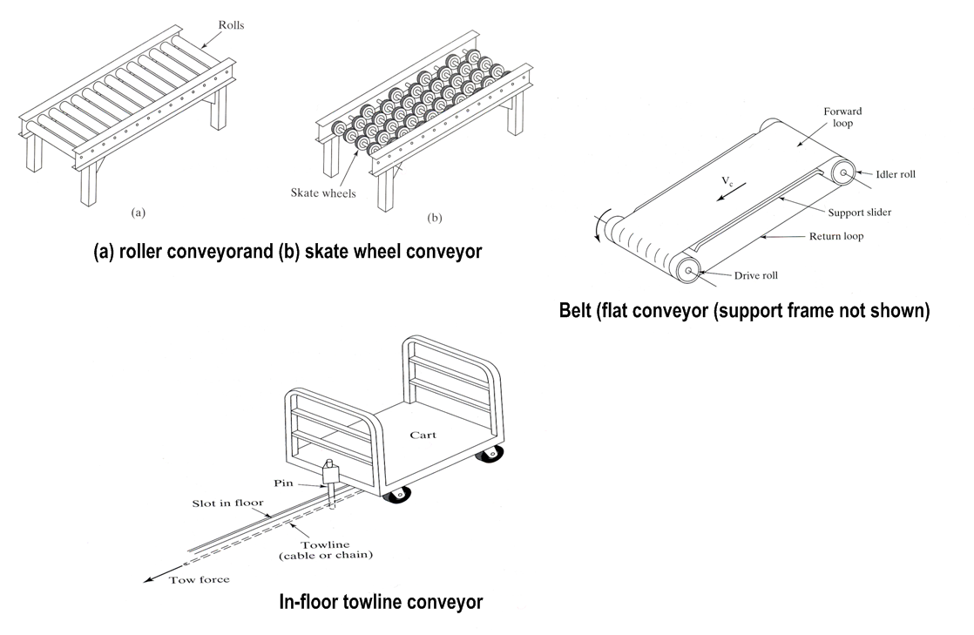

Slide 44
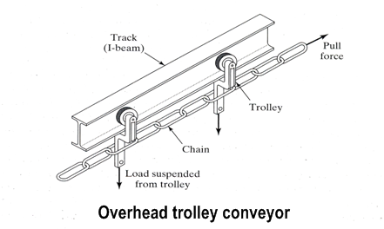
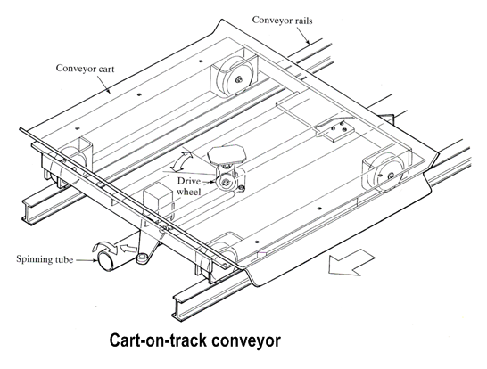

Slide 45
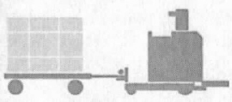
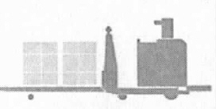
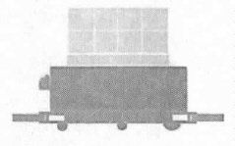
Automated Guided Vehicle Systems (AGVS):Vehicle Types
Driverless train: a guided vehicle tows several trailers carrying heavy loads (up to 50,000 lbs) over long distances.
Tow
train
Pallet truck: a manually loaded guided vehicle for dispatching medium-duty (<6000 lbs) pallets along a guide path on demand.
Pallet
truck
Unit-load carrier: a lighter duty (500-1000 lbs) version of the pallet truck with its own automatic load/unload mechanisms.
Unit load
carrier
Maximum speed for all is 3 mi/hr = 264 ft/min

Slide 46
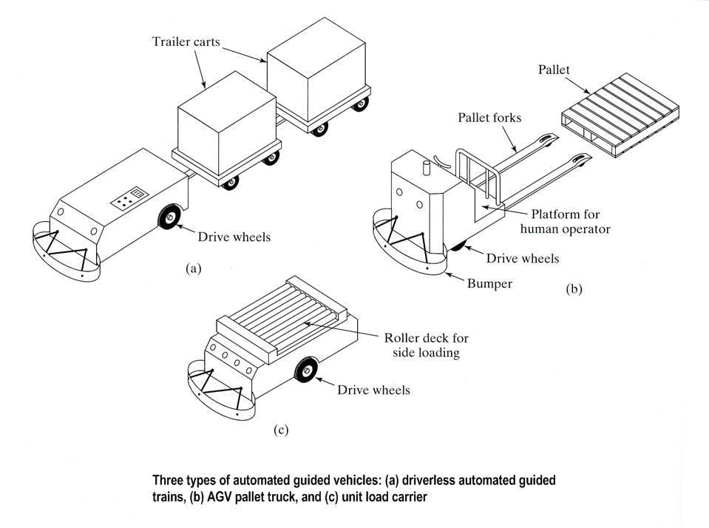

Slide 47
Automated Guided Vehicle Systems (AGVS): Factory Applications
Warehousing, shipping and receiving: moving large quantities over large distances in large factories and warehouses typically require drivereless trains.
Storage and distribution: unit load carriers and pallet trucks typically move materials randomly and in varied quantities to and from automated storage systems.
Assembly-Lines: extra light duty (<500 lb) unit-load carriers move part kits between workstations assembling several variations of the product on the assembly line
(4-10min cycle time)
FMS: unit-load carriers and pallet trucks move parts and tools between workstations, staging areas and storage areas under the control of the FMS supervisory controller.

Slide 48
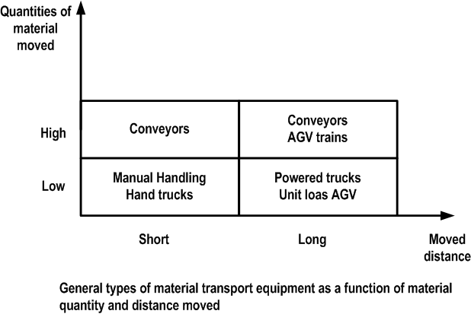

Slide 49
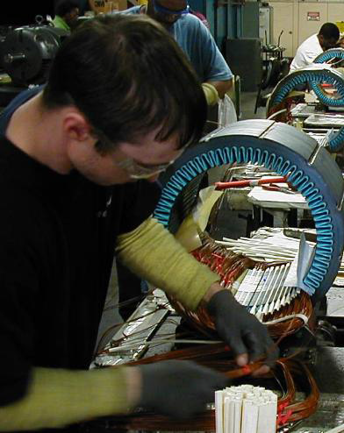
Ergonomic Risk Assessment (ERA)
Purpose
Identify Problem Jobs
• Involve employees
Quantify Risk Factors
• Establish Baseline and Benchmark Improvements
Reduce Potential Disorders and Improve Work

Slide 50
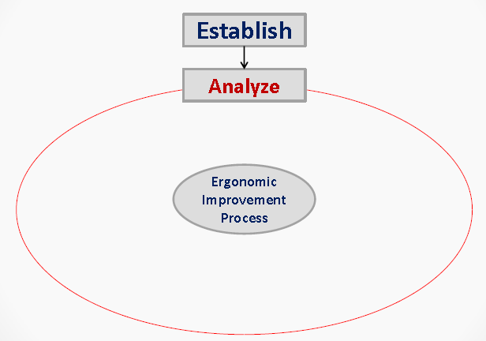





Ergonomic Risk Assessment Process

Slide 51
Ergonomic Risk Assessment:
Where to Start?
Loss History
Incident Data
OSHA logs
Worker’s Compensation Information
Employees
Input & Feedback
Surveys
Workplace Observations
Visual Cues
Job Analysis/Risk Factors

Slide 52
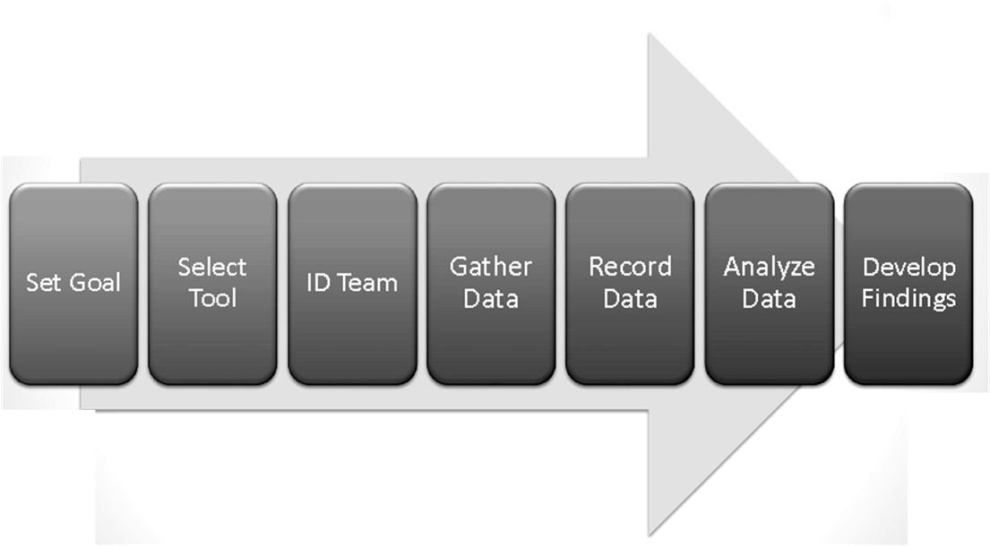
Performing an Assessment

Slide 53
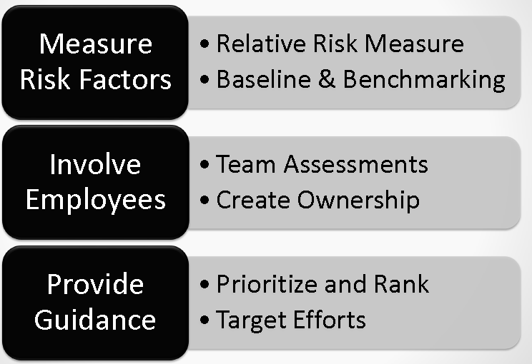
Set Goals for Assessment

Slide 54
Prioritize
• Numerical Scores and corresponding Risk Ratings (RPN)
– Exposure base
• Recordable Incidents and Reports of Discomfort
– Hot Spots
– Potential problems

Slide 55
Implement
• Identify Effective Controls
– Ergo committee brainstorming
– Use Hierarchy of Controls
1.Engineering
2.Administrative
3.Work Practices
• Select Effective Controls
– Communicate with employees
• Implement Controls

Slide 56
Follow-up
• Verify Controls are Correctly Implemented
• Obtain employee feedback
• Formal Review after break-in period

Slide 57
Measure
• Short Term and Long Term Metrics
– Lagging Long Term Measures
• ergo incidents rates & DART rates
• Employee complaints
– Proactive Short Term Measures
• # of Assessments performed
• RPN reductions
• Ergo training
• Ergo assessments of new operations/MOC

Slide 58
Communicate
• Communication at all levels
• Collect employee feedback on ergo
conditions regularly

Slide 59
Ergonomics Risk Factors
Contributing Factors
Environmental Factors
● Awkward Posture
● Excessive Force
● Repetitive Motion
● Static Loading
● Contact Stress
►Noise
►Temperature
►Lighting/glare
►Vibration

Slide 60
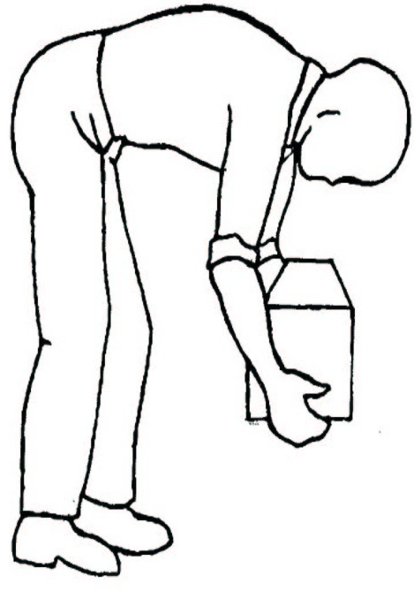
Primary Risk Factors
Repetitive Movements
Leading cause of MSDs
Same joints /muscle groups
(keyboarding, mousing)
Forceful Movements
Excessive movements for long
periods of time (e.g. extended reach)
Fixed or Awkward Postures
Cause fatigue (sitting rigidly for long
periods; reaching above shoulder)
Bending, Twisting and Heavy Lifting

Slide 61
Secondary Risk Factors
Contact Pressure (holding tools, stapling, resting wrists while typing)
Cold Exposure (working outside)
Infrequent, heavy lifting (picking up a water jug; box of paper for photocopier)
Remember Frequency and Duration are key

Slide 62
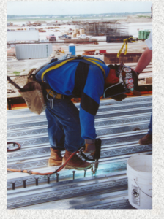


What Risk Factors Can Cause MSD Injuries?
Awkward Postures
Repetition

Slide 63


Excessive Force
Static Posture

Slide 64






Vibration
Poorly Designed Tools

Slide 65

Extreme Temperature
Poor Work Organization
This refers to the way jobs are structured, carried out, and supervised, for example:
Production schedule demands
Infrequent rest breaks
Not enough workers
Poor planning
Poor supervision

Slide 66
Controlling Ergonomic Hazards
Workstation Design—(desks, chairs, space, layout)
Working in Prolonged Positions Sitting/Standing--(alternate postures, footwear, floors)
Work Organization (Pace, Breaks, Variety)
Tools, Equipment, and Furniture Design---(body size, height, gender, promoting neutral postures, reduced vibration, exposure to acceptable lighting, noise, temperature
Manual Materials Handling—(lifting, lowering, pulling, pushing, carrying and holding materials)
Work Environment—(ventilation, noise, temperature & humidity, lighting and vision)

Slide 67

Hierarchy of Control

Slide 68



Modifying Workplace Layout And Equipment
Gantry crane
Raise work level by use of
self-adjusting platform
Use levers to reduce the force required

Slide 69

Modifying The Load
Reduce the risk by lightening the load
Lift S.M.A.R.T.
Size up the load
Move close to the load
Always bend the knees
Raise the object with your legs
Turn by moving your feet

Slide 70


Controlling The Work Environment
Worker in inadequate space. The pellet should be moved.
Good work layout with sufficient space

Slide 71
Examples of Manual Handling Controls
Avoid extreme range of motion when lifting
Redesign work station/work area to allow freedom of movement
Provide handles on material handling equipment
Provide lift-assist devices and tables
Unit Load Concept

Slide 72



ERGONOMIC PRINCIPLES THAT CONTRIBUTE TO GOOD WORKPLACE DESIGN
ERGONOMIC PRINCIPLE |  | DESCRIPTION
Joints must be in a neutral position |  | In the neutral position the muscles and ligaments, which span the joints, are stretched to the least possible extent
Keep work close to the body |  | If the work is too far from the body, the arms will be outstretched and the trunk bent over forwards
Avoid bending forward |  | The upper part of the body of an adult weighs about 40kg on average. The further the trunk is bent forwards, the harder it is for the muscles and ligaments of the back to maintain the upper body in balance

Slide 73




ERGONOMIC PRINCIPLE |  | DESCRIPTION
A twisted trunk strains the back |  | Twisted postures of the trunk cause undesirable stress to the spine
Alternate posture as well as movements |  | No posture or movement should be maintained for a long period of time. Prolonged postures and repetitive movements are tiring.
Avoid excessive reaches |  | It is necessary to limit the extent of forward and sideways reaches to avoid having to bend over or twist the trunk.
Avoid carrying out tasks above shoulder level |  | The hands and elbows should be well below shoulder level when carrying out a task

Slide 74




ERGONOMIC PRINCIPLE |  | DESCRIPTION
Limit the weight of a load that is lifted |  | There are guidance weight limits for both males and females
Use mechanical aids |  | Many lifting accessories are available to help lift and move loads
Avoid carrying loads with one hand |  | When only one hand is used to carry a load, the body is subject to mechanical stress
Use transport accessories |  | There are a large number of accessories such as roller conveyors, conveyor belts, trolleys and mobile raising platforms, which eliminate or reduce manual handling.

Slide 75

GUIDELINE WEIGHTS

